Slide 1
FLIGHT PRICE PREDICTION

Slide 2
PROBLEM STATEMENT AND UNDERSTANDING

Slide 3
As we all know, we can get flight fare for cheap and expensive. When we try to book a flight ticket today, for travelling tomorrow the fare may get higher. While we try to book flight for 2 weeks before travelling we may get cheap rate. So fare may vary in this factor and also if the flight is not direct to our destination it may also varies. According to the airlines also fare may vary. So this is the problem of this project. Now let’s build a machine learning model what are the factors may affect in flight fare.

Slide 4
EDA STEPS AND VISUALIZATIONS

Slide 5
Eda steps
I have scrapped around 1700 entries with 9 variables.
Dataset have no null values.
Features are majority about time like duration, departure time, arrival time.
We want to treat it with appropriate functions.
Duration is given in this format like ‘3h 5m’, I try to extract hour and minute separately and two new columns duration hours and duration minutes. And drop the duration column.
And in departure time columns also I seperate hour and minute separately and two columns respectively for hour and minute. Dropped departure time column from dataset permanently.
Same step I perform on the feature arrival time. But the data have some unwanted substances I replace it and perform the above function and dropped arrival time feature permenently.

Slide 6
Now let’s check about the dates, dates are given in this format ‘Tue, 22 Feb 2022’ I replaced it with the format ‘dd/mm/yyyy’ using replace function.
Then I separate the date and month separately. The year is common for all dates so I skip that and drop the date column permanently.
Then our target variable price is in object type, we want to convert it into numeric.
First of all we want to replace the ‘,’ (comma) from the data and then convert it into numeric using pandas.
Now let’s perform some encoding techniques in categorical features.
Perform one hot encoding in features ‘Airlines’ and ;’Total Stops’ features.
While the features ‘Source’ and ‘Destination’ I perform the label encoding.

Slide 7
When I try to remove outliers, there is such a big loss of data, so I proceed with outliers.
Separated features and target, check Multicollinearity among features and there is no multi collinearity.
Checked for skewness and removed it
Features were scaled.

Slide 8
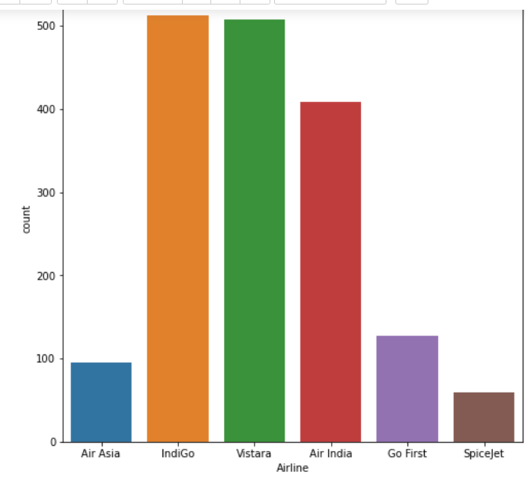
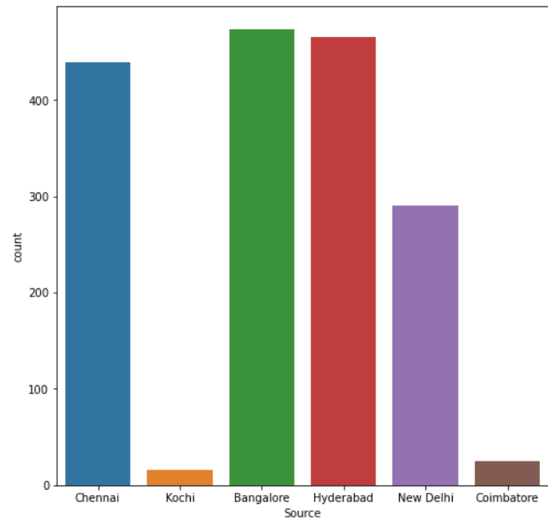
visualizations

Slide 9
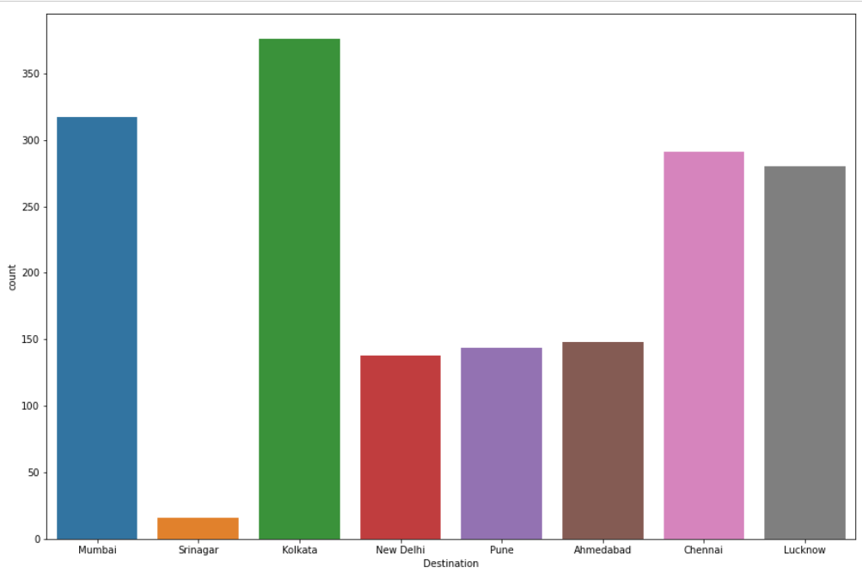

Slide 10
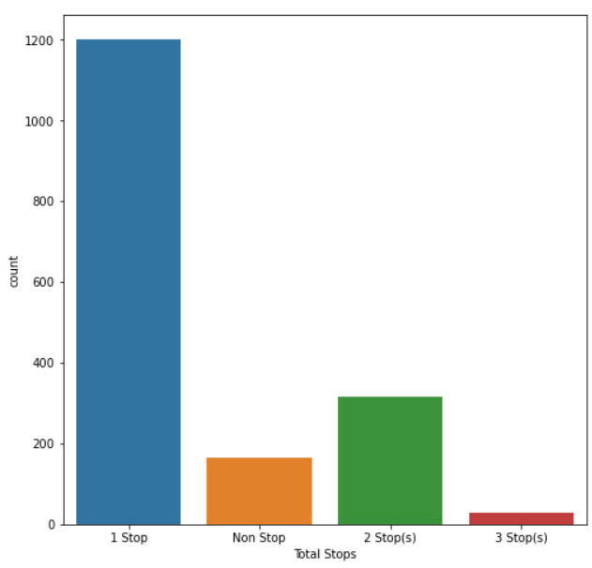

Slide 11
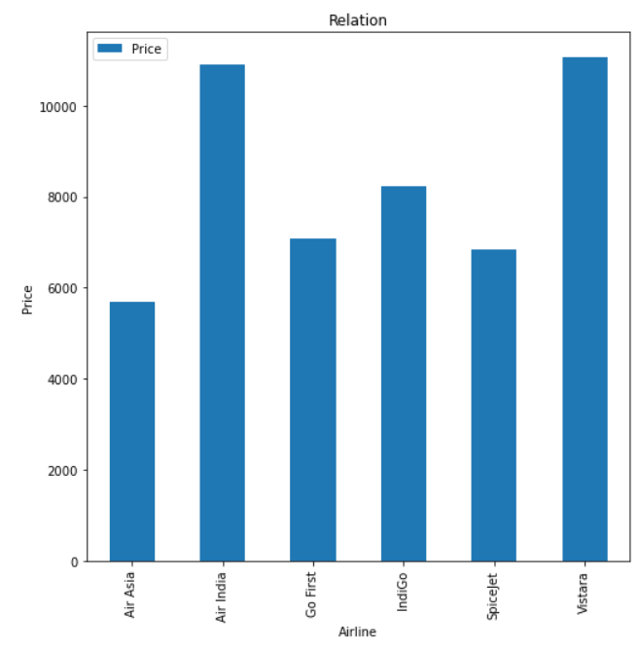
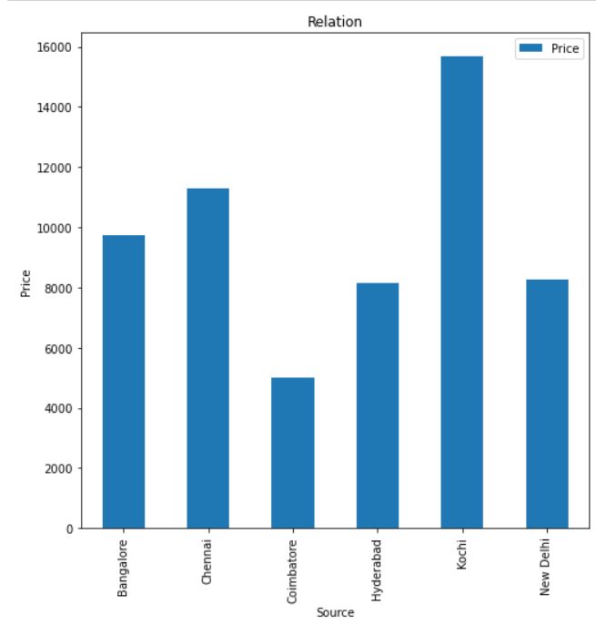
Bivariate analysis
Price and Airlines
Source and Price

Slide 12
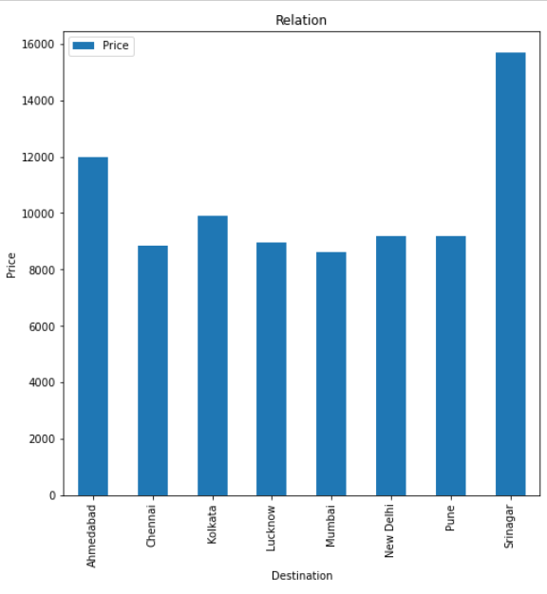
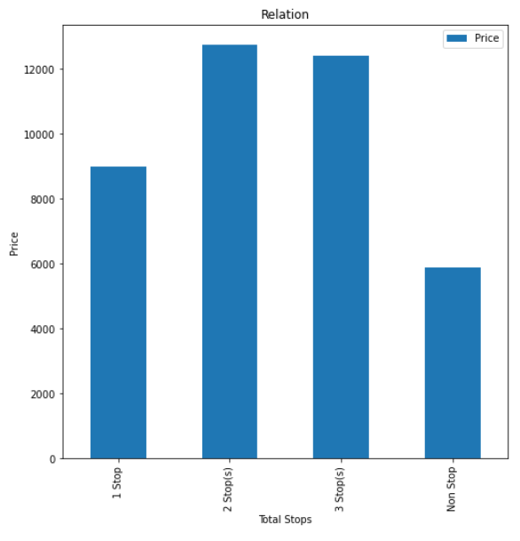
Destination and Price
Total Stops and Price

Slide 13
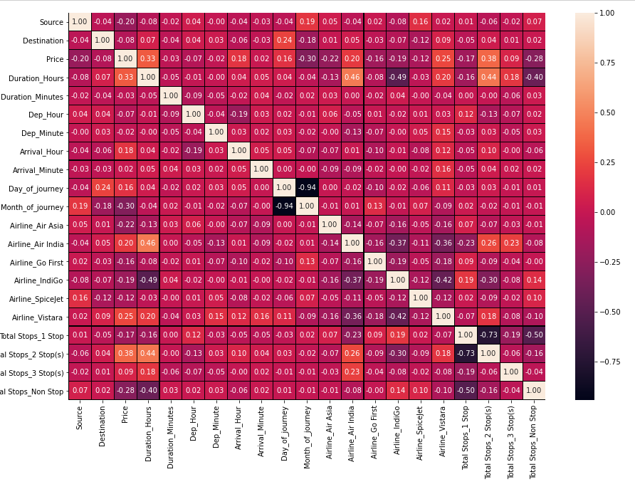
correlation

Slide 14
Steps and assumptions

Slide 15
Flight fares are expensive in seasons like Christmas, Eid in festival season the fare may get expensive.
In this project we scrapped about the domestic fares.
Fare may expensive when it demands if we try to book flight in before one day of travelling.
Get cheap fare if we try to book before 2 weeks.
If the flight is connected flight it may vary in fare.
We are looking the fare of economy class in this project, but the business class and first class is really expensive. But it have some features.

Slide 16
Model dashboard
Here I used five different models for prediction.
One ensemble technique random forest and one boosting technique XG boost.
As we have low data in dataset gives low accuracy, here good accuracy is above 68%.
To finalize the model I check the cross validation and r2 score for each model.
Xg boost have low difference in r2 score and cross validation score.
So I prefer it as the best model and tuned with best parameters.

Slide 17
conclusion

Slide 18
Flight fare may vary while airline company changes.
Booking flight before two weeks of travelling will give low price and cheap fare.
Booking the direct flight will vary the fare and gives cheap fare.
As we check the predictions on domestic airlines, but in international travelling may vary in different ways. Such as the festival seasons the ticket fare may be expensive.

